Slide 1
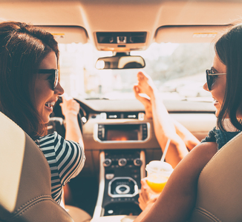
CAReful
Mobile and Social Sensing Systems
Academic Year: 2021-22
Cancello Tortora Giuseppe
Casini Mirko
Lagna Andrea
Marino Martina

Slide 2
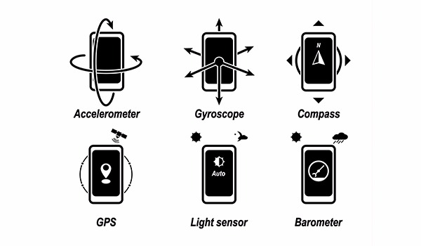
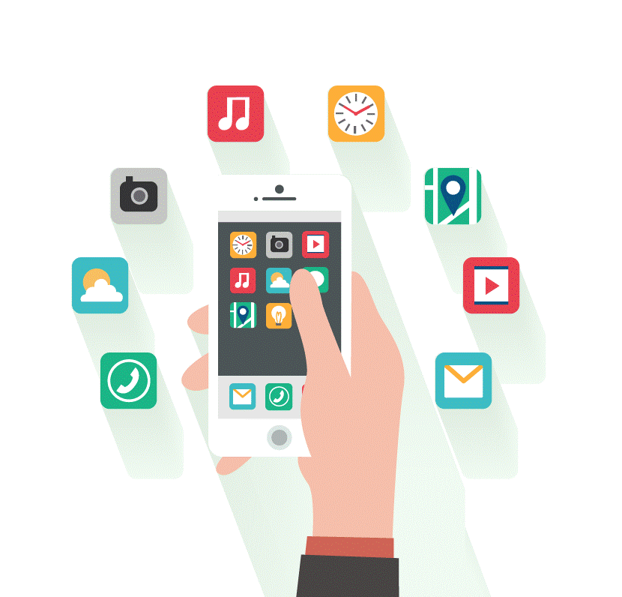
Overview
Introduction
Sensors
Application
Conclusions

Slide 3
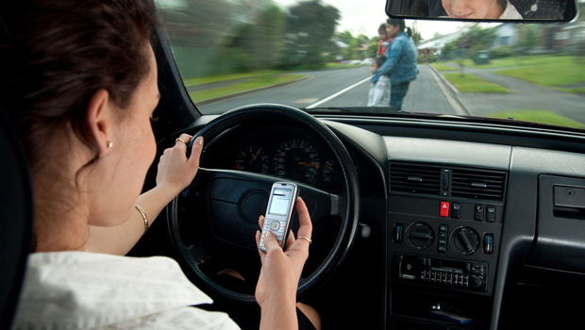
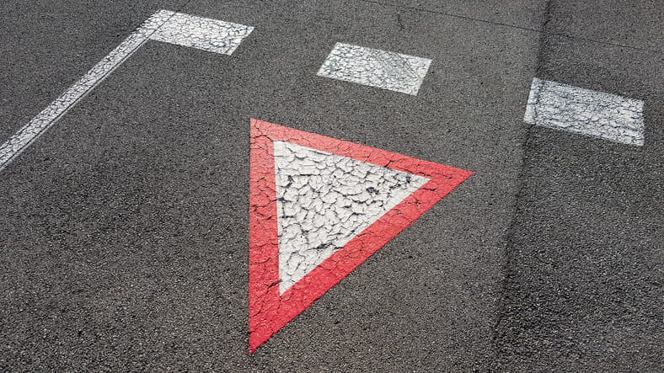
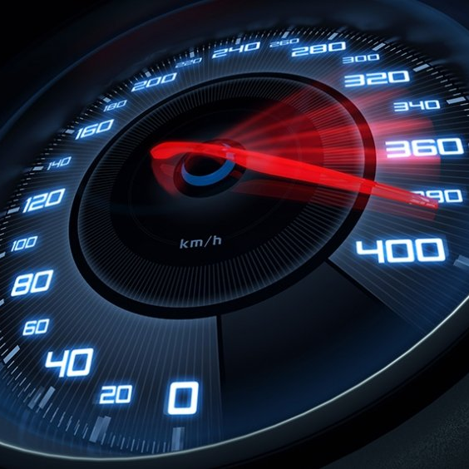
Introduction
Among the wrong driving behaviours, the most frequent are the distraction, the lack of respect for precedence and too high speed. The three groups together make up 40.2% of cases (60,981). Istat – Incidenti stradali [Published in July 2021]
Notes:
https://www.google.com/url?sa=t&rct=j&q=&esrc=s&source=web&cd=&cad=rja&uact=8&ved=2ahUKEwjdj4yGxuz3AhUJwQIHHfB0C2kQFnoECAUQAQ&url=https%3A%2F%2Fwww.istat.it%2Fit%2Ffiles%2F2021%2F07%2FIncidenti-stradali_2020.pdf&usg=AOvVaw2QVarvSark3hO7KWcyuPC6
Link documento ISTAT

Slide 4
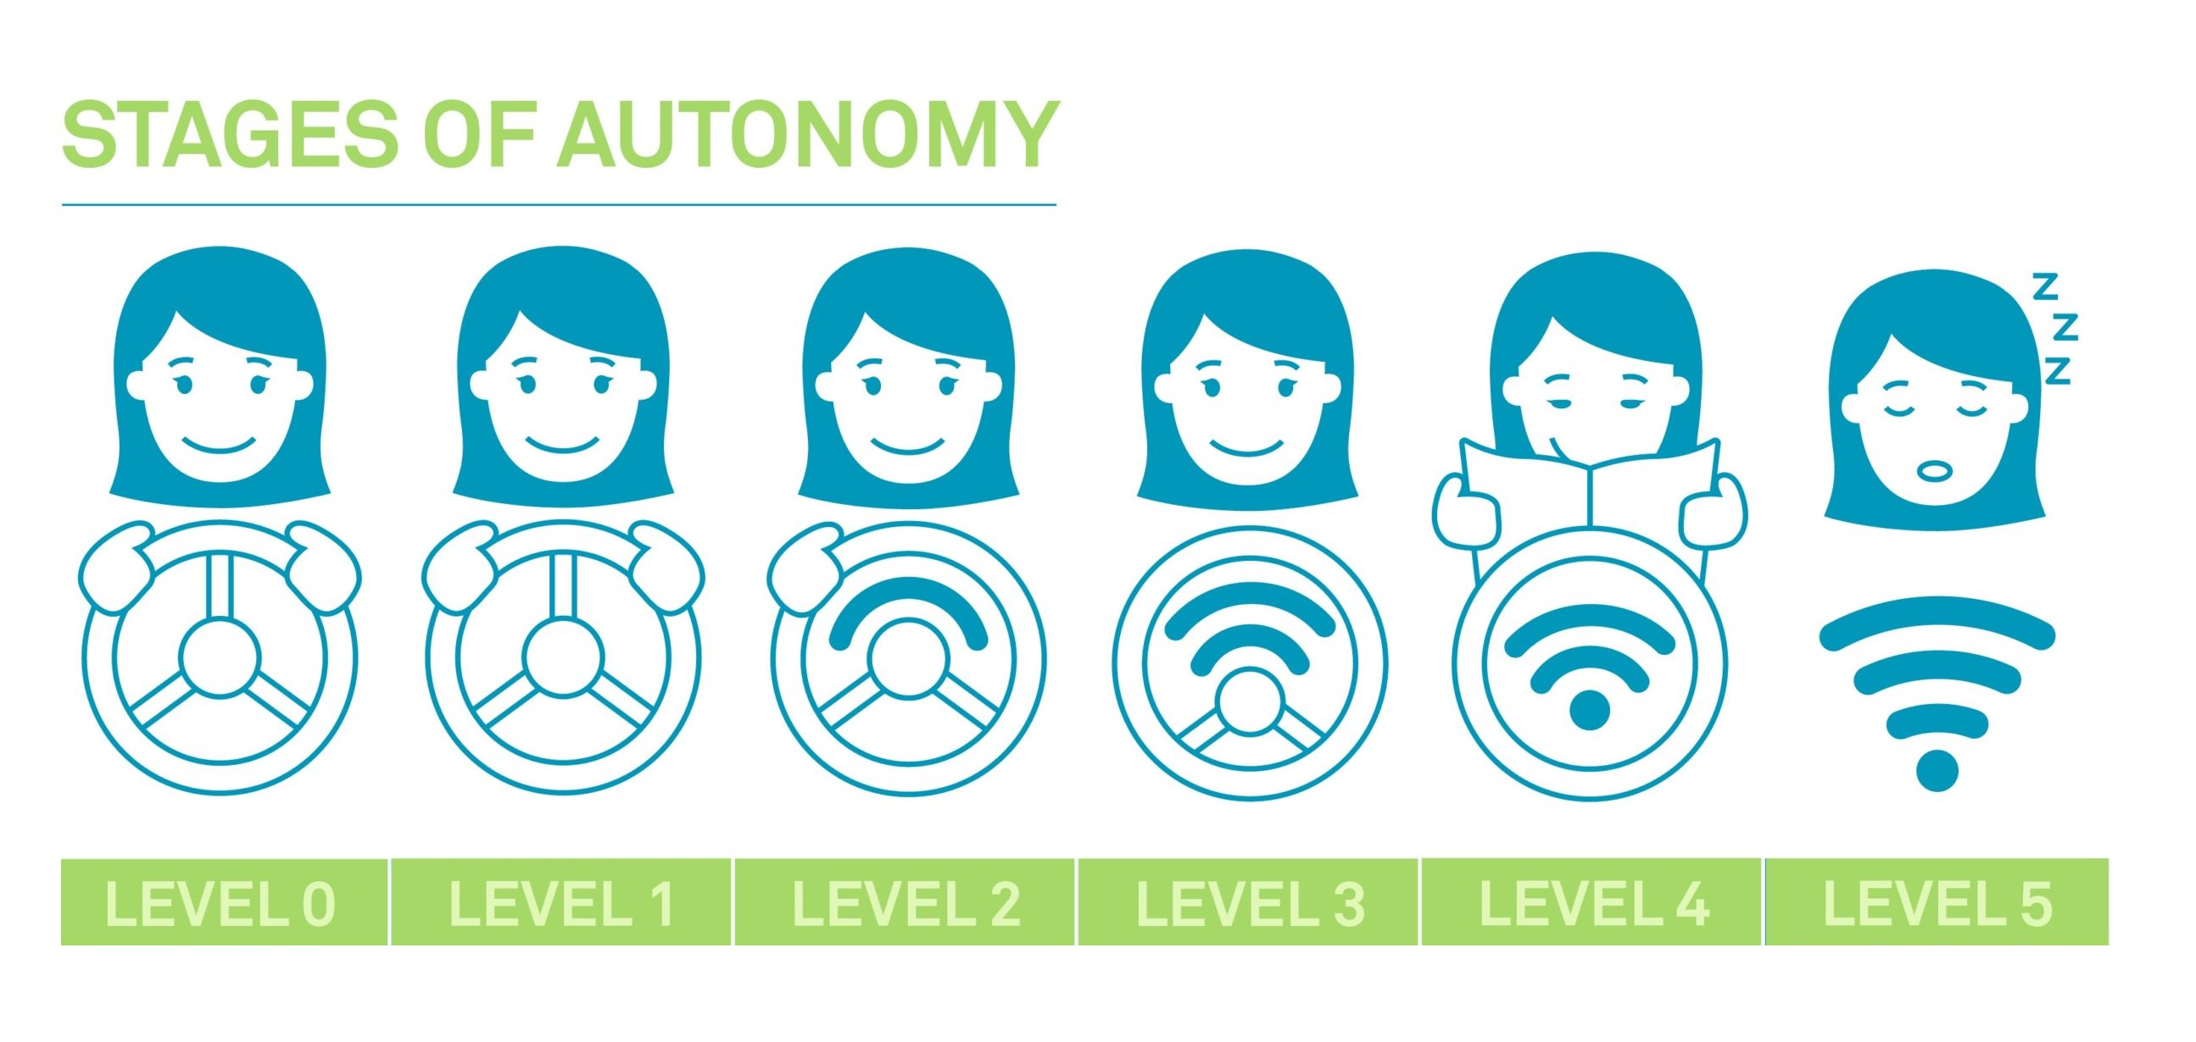
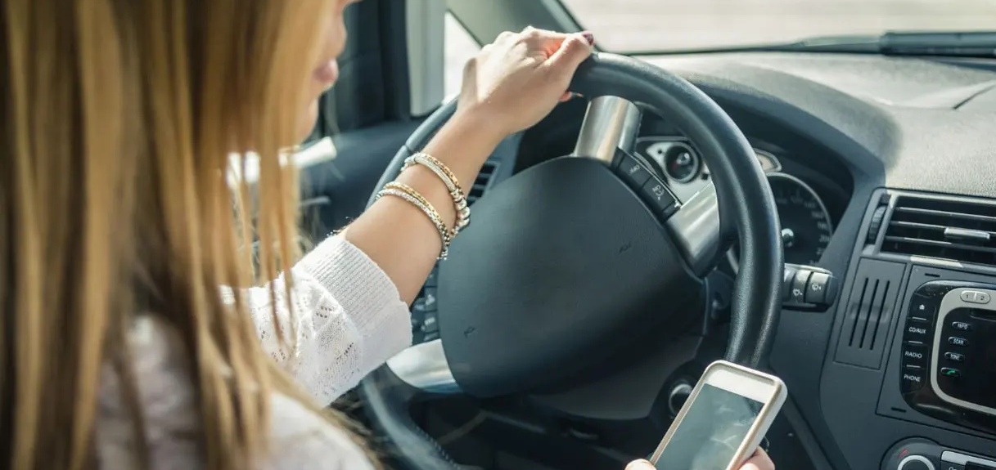
Distractions
Despite the increasing automation of driving vehicles, we are so far from the full automation. So, the driver has to perform all the main tasks of driving with full attention.
Any non-driving activity is a potential distraction and increases the risk of crashing, in particular at high speed or curvy roads.
Examples of distractions are:
Usage of the smartphone
Looking away from the road
Drowsiness
Too much noise

Slide 5
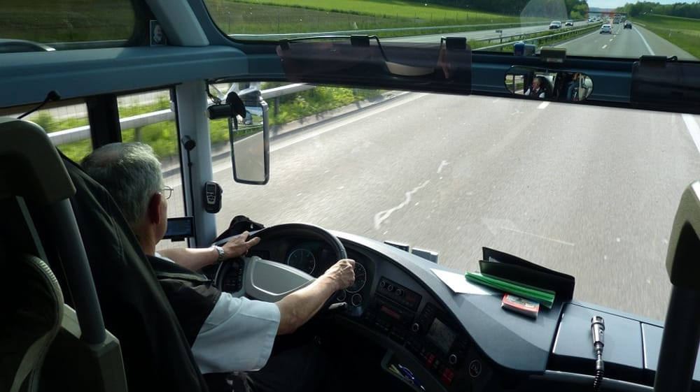
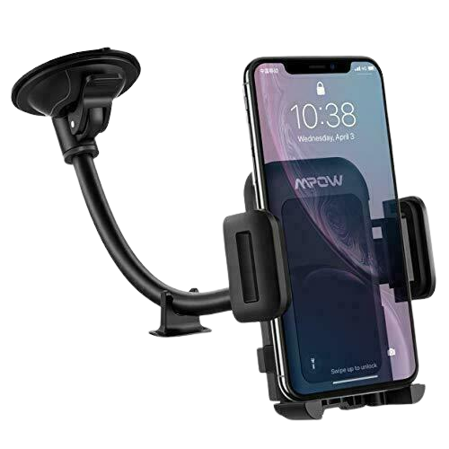
Idea
Our idea is a simple application able to detect the different distractions while driving. When you start a new trip, you have just simply to place the phone in front of you and the application performs by its own.
Various uses can be designed for the application:
personal use to test your attention while driving
monitor the attention of a bus driver in a company
an insurance company to categorize drivers

Slide 6
Exploited sensors
Camera
Drowsiness and head rotation
GPS
Track position and speed detection
Microphone
Analyze noise around the driver
Accelerometer & Gyroscope
Accelerometer & Magnetometer
Fall and usage detection
Road curvature detection

Slide 7
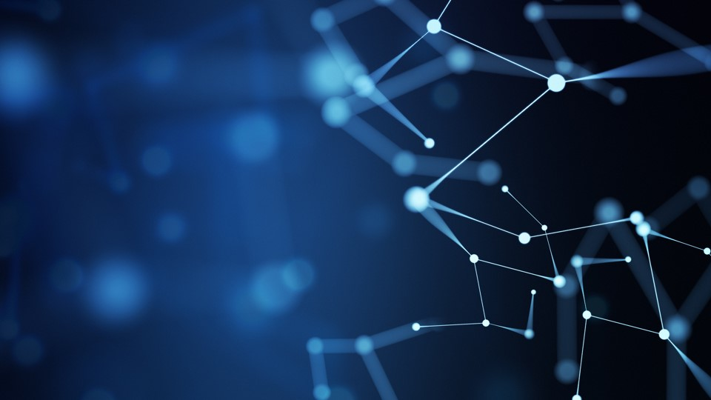
Sensors

Slide 8


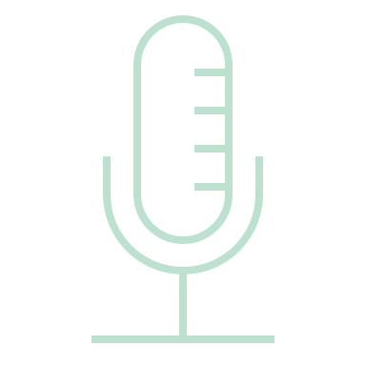


Sensors
Camera
Accelerometer & Magnetometer
Microphone
Accelerometer & Gyroscope
GPS

Slide 9
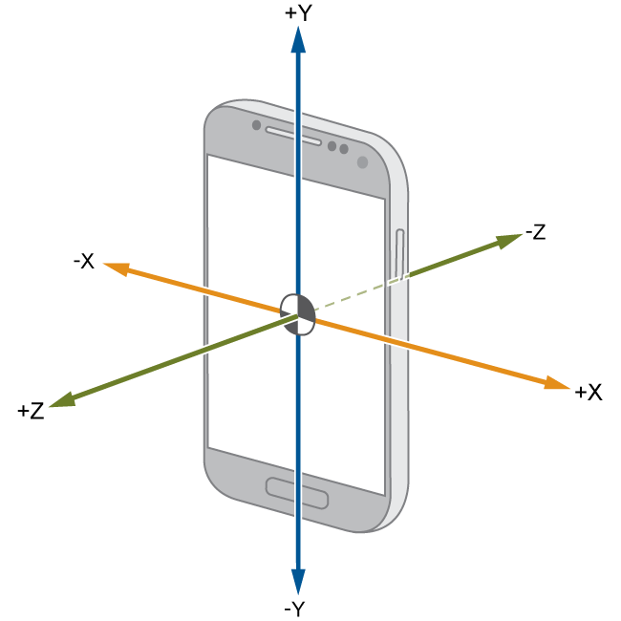

Accelerometer & Gyroscope
USAGE DETECTION
MAGNITUDE
$$m=\sqrt{x^{2}+y^{2}+z^{2}}$$
THRESHOLDS
lowThreshold = 5.0
highThreshold = 18.0
gyroThreshold = 1.9
FALL DETECTION
arraySize = 8
samplingPeriod = 200 ms

Slide 10
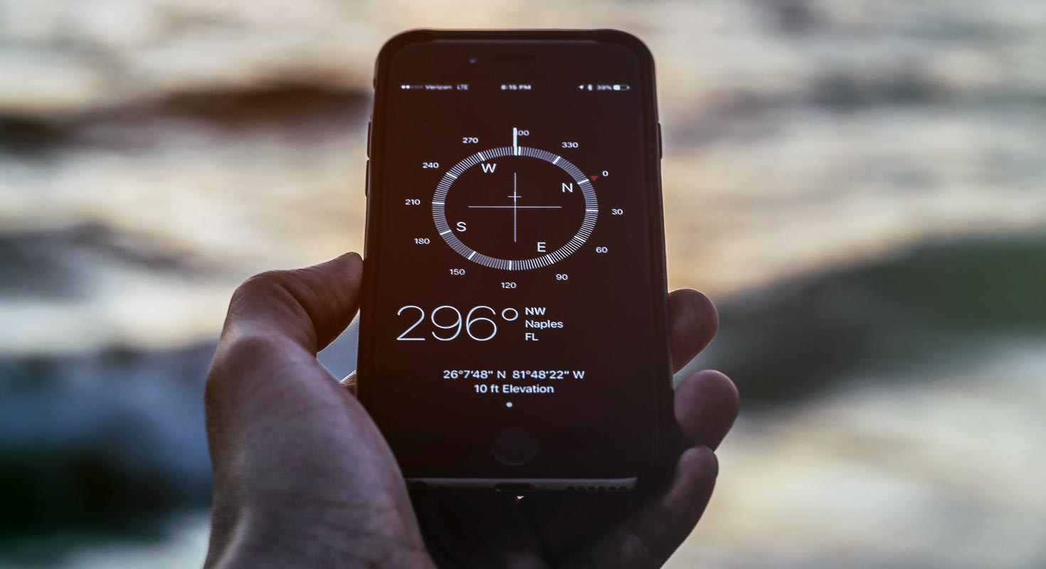



Accelerometer & Magnetometer
RISK INDEX
$$sum<10 →1$$
$$10≤sum<60 →2$$
$$sum≥60 →3$$
SAMPLING PERIOD
$\sim$200 ms
AZIMUT
$$−π, +π$$
arraySize = 300
ROAD CURVATURE

Slide 11
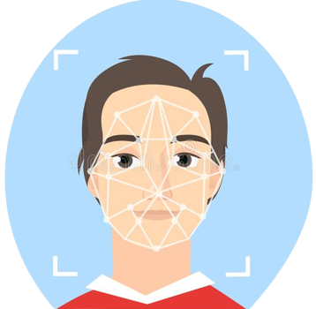


Camera
THRESHOLD
DROWSINESS
DETECTION
P(left and right eye open) < 0,5
2 s
HEAD ORIENTATION
ML KIT
$≥$40° | 4 s
Face detection API

Slide 12
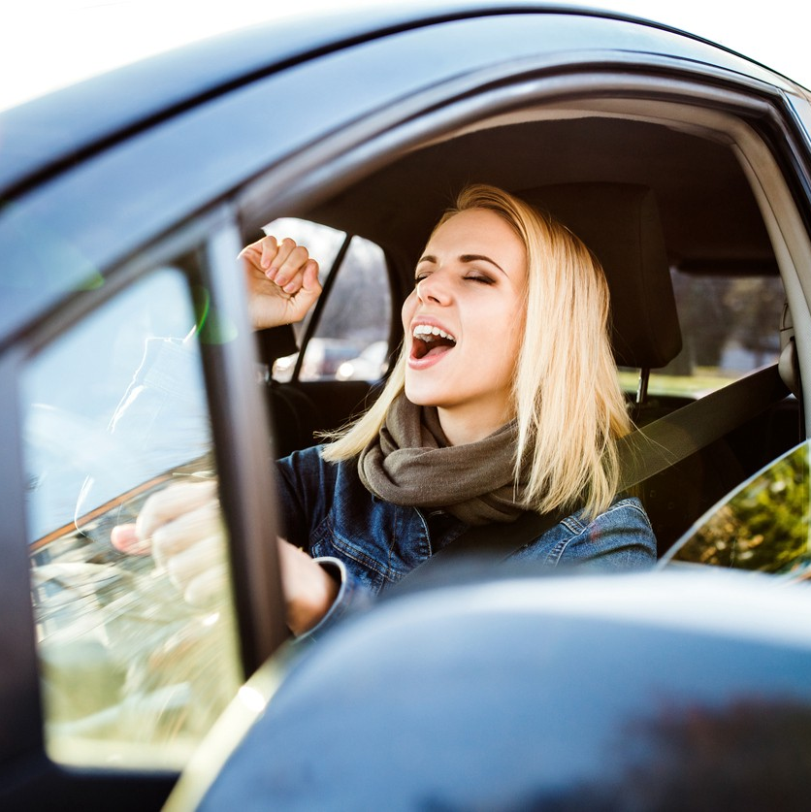

Microphone
DECIBEL DETECTION
TIME
THRESHOLD
5 s
NOISE
DETECTION
$≥$150.0 dB

Slide 13
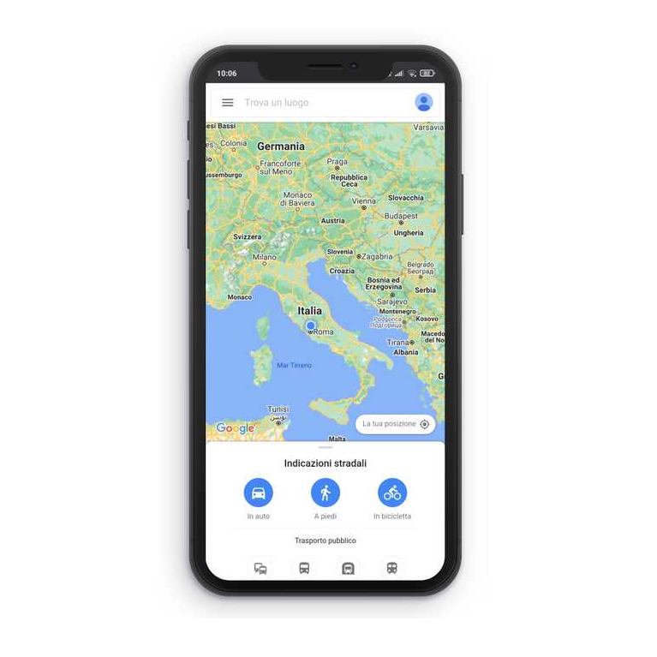
GPS
AVERAGE SPEED
ROAD MAP
4 ranges
Google Maps API
5 sec
SAMPLING PERIOD
TRIP INFO
Departure and arrival locations

Slide 14
Distraction Weights
 | Role | Range | Description
Road curvature | Multiplier | 1 - 3 | Difficulty of the road
Car speed | Multiplier | 1 - 4 | Speed of the car
Drowsiness detection | Adder/Counter | 0 - 30 | How many times eyes are closed
Head Turned detection | Adder/Counter | 0 - 12 | How many times head is turned
Usage detection | Adder/Counter | 0 - 1 | How many times the phone is used
Fall detection | Adder/Counter | 0 - 293 | How many times the phone fall
Noise detection | Adder/Counter | 0 - 12 | How many times there is noise in the car

Slide 15


AttentionLevel Formula*
$$disattention=\left(\frac{speed}{4}+ \frac{curvature}{3}\right) ∗\left(\frac{head}{12}+\frac{drowsiness}{30}+usage+\frac{noise}{12}+\frac{fall}{5}\right)$$
$${disattentionLevel}_{i}=α ∗disattention+\left(1−α\right)∗{disattentionLevel}_{i−1}$$
$$attentionLevel=10 −disattentionLevel$$
*computed every 1 min

Slide 16
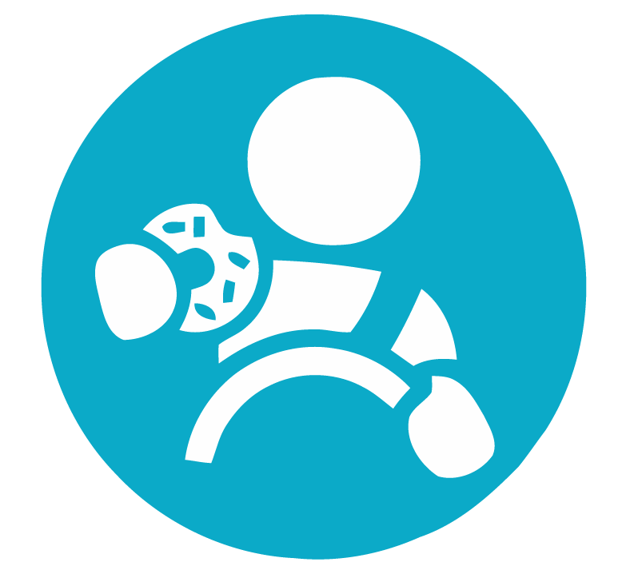
Application

Slide 17
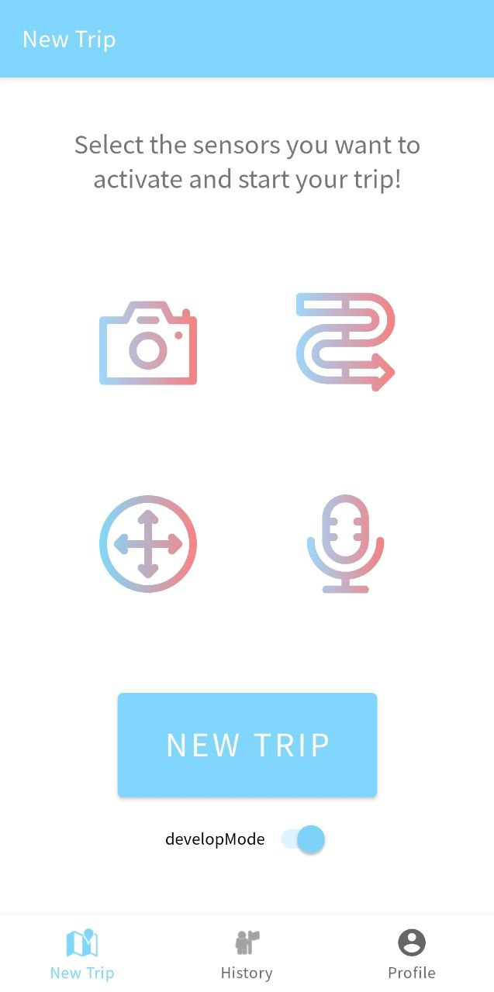
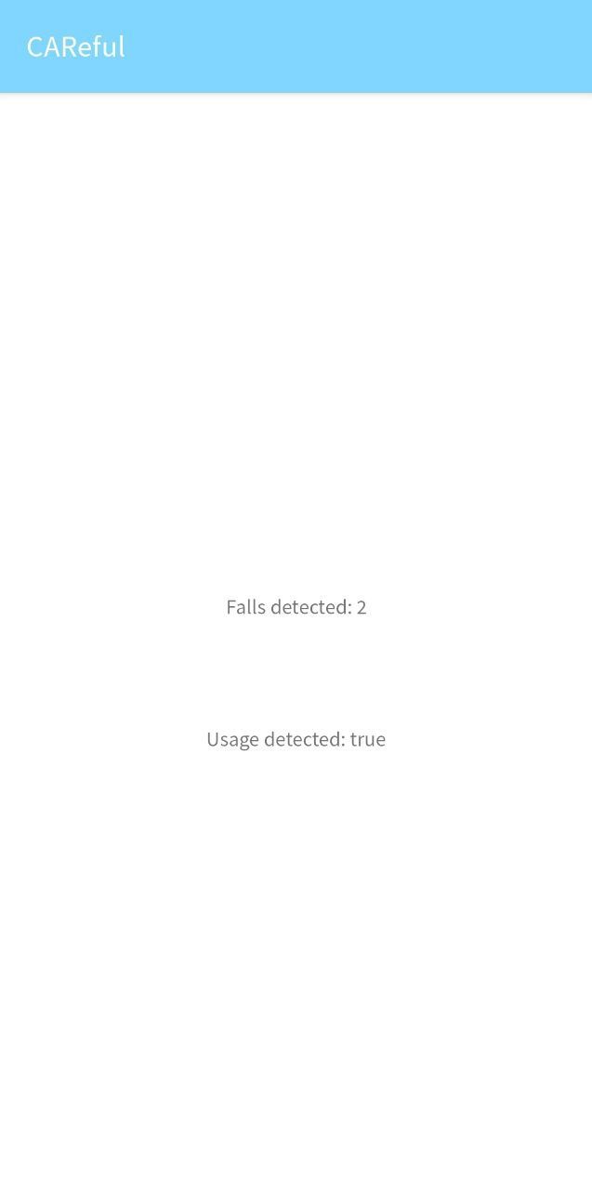
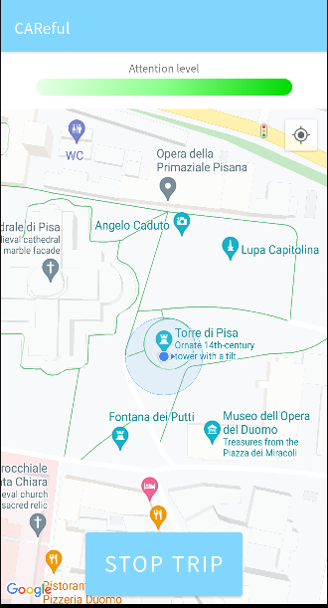
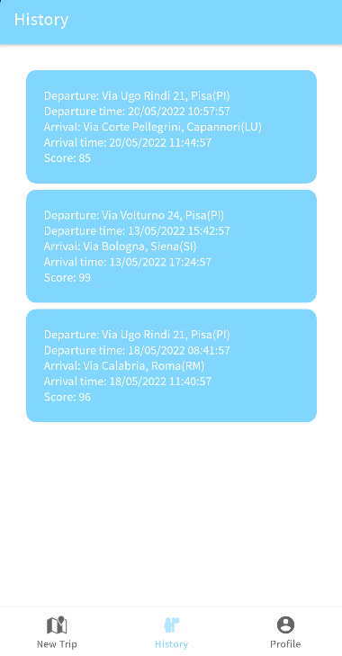
CAReful

Slide 18
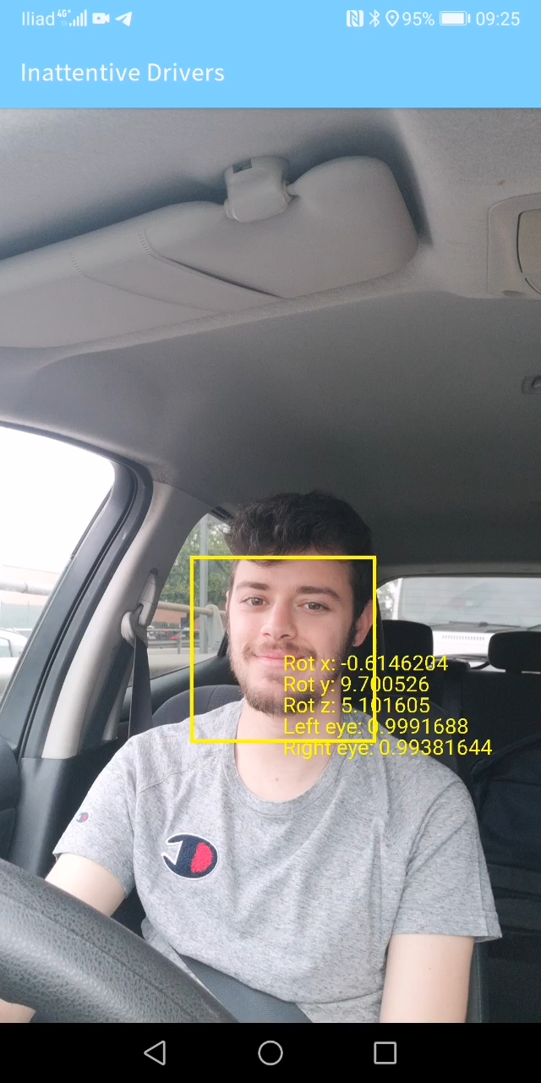
Video
Camera - Develop mode example

Slide 19
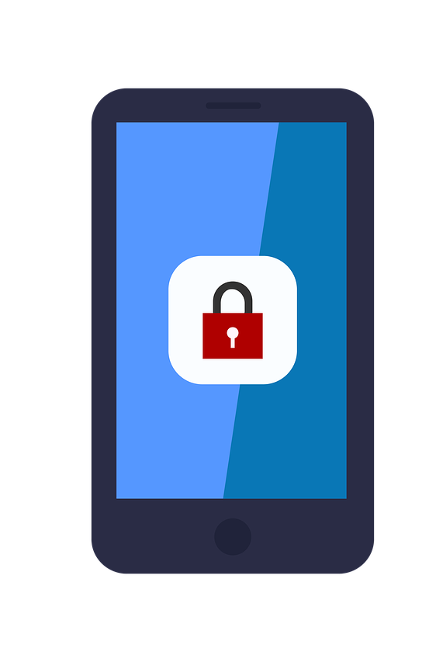

Privacy
Real-time evaluation of sensors’ information
No sensitive data are stored (e.g. microphone/video recordings)
Trip details stored:
departure and arrival location
departure and arrival time
score.
Local SQLite db is used

Slide 20
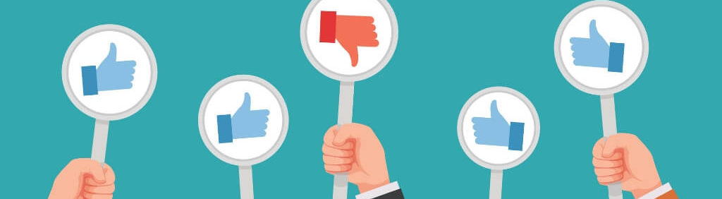
Limits of the application
Does not detect the eyes if you wear sunglasses, but it works with eyeglasses
Requires precise positioning of the phone
Some threshold values may not be correct under particular conditions

Slide 21

Future improvements
Detect if the driver has something in his hands and what it has (food, drink, cigarettes)
Detect and classify noises, understanding if they are speeches, music or other.

Slide 22
Thanks for the attention
Questions are welcome!

